Slide 1


Slide 2
HID-BPF in the kernel,
2 years later
Benjamin Tissoires & Peter Hutterer
bentiss@kernel.org
peter.hutterer@redhat.com

Slide 3
Introduction (sort of)

Slide 4
This is a follow up talk from LPC 2022, in Dublin
Please refer to that previous talk for details about HID and why HID-BPF was required

Slide 5
This is a follow up talk from LPC 2022, in Dublin
Please refer to that previous talk for details about HID and why HID-BPF was required
It was a great talk, I assure you that

Slide 6
This is a follow up talk from LPC 2022, in Dublin
Please refer to that previous talk for details about HID and why HID-BPF was required
It was a great talk, I assure you that
Really, I mean it

Slide 7
This is a follow up talk from LPC 2022, in Dublin
Please refer to that previous talk for details about HID and why HID-BPF was required
It was a great talk, I assure you that
Really, I mean it
But for those who were not there

Slide 8

HID-BPF overview
kernel
HID Report Descriptor
05 01 09 02 a1 01 85 01 09 01 a1
hid-generic
HID Report events
01 02 00 03 05 00 00

Slide 9

HID-BPF overview
kernel
HID Report Descriptor
05 01 09 02 a1 01 85 01 09 01 a1
BPF
Prog
HID Report Descriptor
05 01 09 02 a1 01 85 01 0b 01 a1
hid-generic
HID Report events
01 02 00 03 05 00 00
HID Report events
01 03 00 03 05 01 0d

Slide 10
HID-BPF - a minimal program
HID_BPF_CONFIG(
HID_DEVICE(BUS_USB, HID_GROUP_GENERIC, VID_HOLTEK, PID_G10)
);
SEC(HID_BPF_RDESC_FIXUP)
int BPF_PROG(hid_fix_rdesc, struct hid_bpf_ctx *hctx)
{
__u8 *data = hid_bpf_get_data(hctx, 0 /* offset */, 4096 /* size */);
if (data)
data[50] = 0x01; // Change report descriptor
return 0;
}
SEC(HID_BPF_DEVICE_EVENT)
int BPF_PROG(disable_button, struct hid_bpf_ctx *hctx)
{
__u8 *data = hid_bpf_get_data(hctx, 0 /* offset */, 9 /* size */);
if (data)
data[1] &= (1 << 3); // Disable bit 3 in second byte of input report
return 0;
}

Slide 11
So it got merged (story time)
HID-BPF got merged in v6.3 (Sun Apr 23, 2023)
Not much happened until November 2023…
But then…

Slide 12

But then
https://www.davidrevoy.com/article995/how-a-kernel-update-broke-my-stylus-need-help

Slide 13
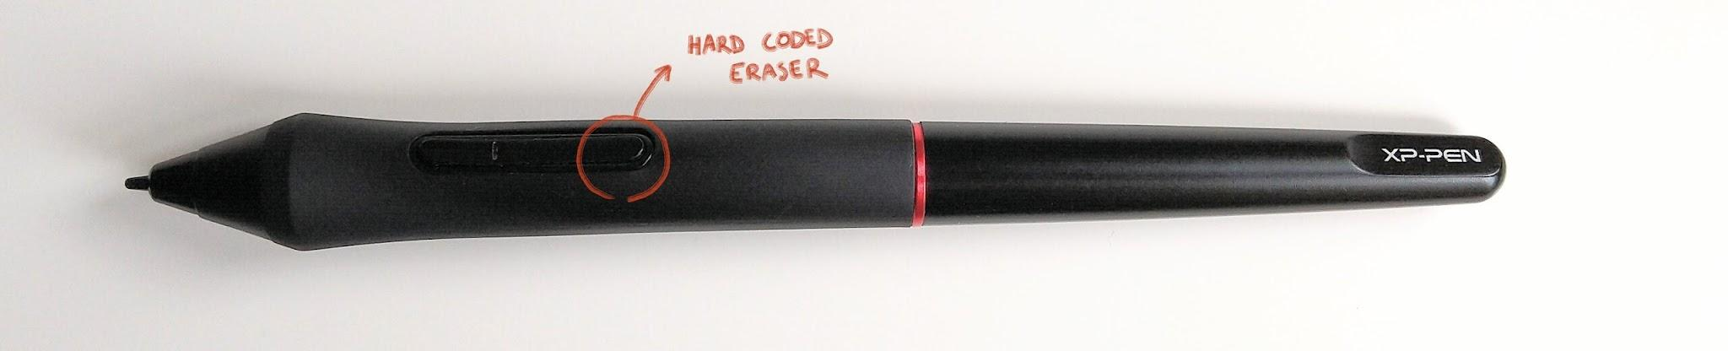
TL;DR:
Bad Innovative design choice from Microsoft:

Slide 14
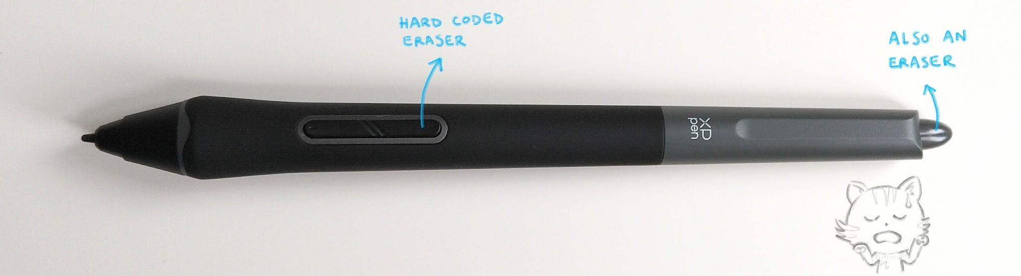
TL;DR:
Bad Innovative design choice from Microsoft:
Even worse innovative-ier design from XP-Pen:

Slide 15

Solved in… 2 days

Slide 16
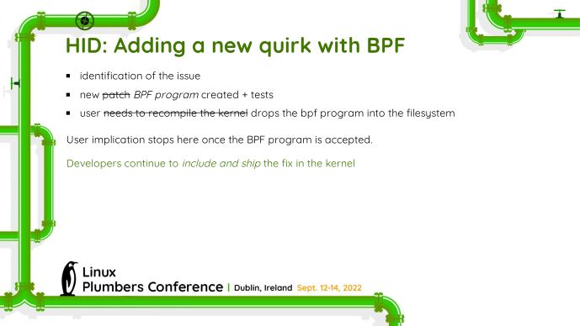
Remember that slide?

Slide 17
Remember that slide?
IT WORKS!

Slide 18
Shortly after
Peter had to fix something by himself:
"holy crap, this was the most enjoyable experience I ever had working with the kernel. hid-bpf is amazing, doubly so with udev-hid-bpf. amazing job you've done there"
This wasn't possible without all of the hard work from the BPF core team and all the users and developers of BPF.
Thank you!

Slide 19
Timeline
Since its first inclusion

Slide 20
HID-BPF Kernel Timeline
v6.3: Started with tracing
v6.10: bpf progs in the kernel
v6.10: new kfuncs
v6.11: struct_ops re-implementation
v6.13: hid-generic control
…
~v6.14: trying to take over the world

Slide 21
v6.10: Current fixes are now integrated in the kernel
located in drivers/hid/bpf/progs
not built by default
not loaded by the kernel
loaded by udev-hid-bpf (we'll discuss that later)
The objective is to have an "upstream" for those and have "normal" development cycle

Slide 22
v6.10 & v6.11: Sleepable contexts
Why?
In David's case, I papered over one sub-case where I would have need to take a decision later
How?
v6.10: bpf_wq in the kernel
  currently no delayed_wq, implemented through a bpf_timer + bpf_wq
v6.11: Full rewrite of HID-BPF by using BPF struct_ops
  truly amazing, simpler, and much more powerful
    you get a small verifier in your own subsystem!
  no more preloading of BPF program at boot (i.e. no overhead when not in used)
Results:
Surface Dial fun: enable/disable haptic feedback with long press
Logitech HID++ in bpf to easier solve some issues
  (high res scrolling)

Slide 23
v6.10: New kfuncs!
hid_bpf_input_report and hid_bpf_try_input_report
  inject one input report from the current BPF execution
hid_bpf_hw_output_report
  call an output report on the device and wait for it to finish
Results:
We now have roughly the same HID API from BPF than in the HID subsystem
control even more devices!
  X-Keys button pads
  Logitech
  etc…

Slide 24
v6.11: New hooks!
hid_hw_raw_request
  called when doing an ioctl on an hidraw device
hid_hw_output_report
  called when doing a write on an hidraw device
for both of them:
  "Source" argument and infinite loop prevention
Results:
HID Firewall is now possible
  HIDIOCREVOKE potentially gives any app a hidraw fd - what if that app decides to flash the firmware?
Emulate HID LampArray on compatible devices
  (my Corsair keyboard requires a key sniffer for that ATM)

Slide 25
v6.13: hid-generic assignment
Some sort of control of the kernel
  force hid-generic to prevent another driver to revert BPF changes

Slide 26
v6.13+: future objectives
Also ensure that we can make use of HID-BPF for any request to the device:
  whether it comes from userspace or from the kernel

Slide 27
udev-hid-bpf
aka “modprobe for HID BPF programs”
https://gitlab.freedesktop.org/libevdev/udev-hid-bpf/

Slide 28
udev-hid-bpf: what is it?
udev-hid-bpf is a collection of HID-BPF programs
udev-hid-bpf is a binary executable like modprobe/insmod
udev-hid-bpf is scaffolding for udev rules/hwdb

Slide 29
udev-hid-bpf: the BPF programs
udev-hid-bpf is a collection of HID-BPF programs - like drivers/hid/hid-*.c
$ tree src/bpf
src/bpf
├── stable
│ ├── 0010-FR-TEC__Raptor-Mach-2.bpf.c
│ ├── 0010-IOGEAR__Kaliber-MMOmentum.bpf.c
│ ├── 0010-XPPen__Artist24.bpf.c
│ └── …
├── testing
│ ├── 0010-Mistel__MD770.bpf.c
│ ├── 0010-Rapoo__M50-Plus-Silent.bpf.c
│ └── …
├── userhacks
│ ├── 0010-Logitech-MX-Master-3B-middle-button.bpf.c
│ ├── 0010-mouse_invert_y.bpf.c
│ ├── 0010-QuinHeng__PCsensor-FootSwitch.bpf.c
│ └── …
← in upstream kernel
← newly added
← have fun…

Slide 30
udev-hid-bpf: the executable
udev-hid-bpf is a generic loader for HID-BPF programs - like modprobe is to kernel modules
udev-hid-bpf add /sys/bus/hid/devices/0003:0F00:0BAF.3 0010-XPPen__Artist24.bpf.o

Slide 31
udev-hid-bpf: the executable
written in Rust, so statically compiled
we can give users a tarball with udev-hid-bpf and the compiled bpf.o files and it’ll just work
plug in device, done
$ tar xz udev-hid-bpf-$version && cd udev-hid-bpf-*/
$ ./udev-hid-bpf install src/bpf/stable/*-Huion__Inspiroy-2-S.bpf.o

Slide 32
udev-hid-bpf: the executable
No skeletons of BPF objects statically compiled into udev-hid-bpf

Slide 33
udev-hid-bpf: the scaffolding
No skeletons of BPF objects statically compiled into udev-hid-bpf
BPF objects include information about what devices they apply to
  Use of new SEC(".hid_bpf_config") for storing the device IDs in the BTF (ala XDP, thanks Toke!)
HID_BPF_CONFIG(
HID_DEVICE(BUS_USB, HID_GROUP_GENERIC, 0x256C /* huion */, 0x66 /* INSPIROY_2_S */),
HID_DEVICE(BUS_USB, HID_GROUP_GENERIC, 0x256C /* huion */, 0x67 /* INSPIROY_2_M */),
);

Slide 34
udev-hid-bpf: the scaffolding
No skeletons of BPF objects statically compiled in udev-hid-bpf
BPF objects include information about what devices they apply to
We extract this to generate udev rules
and a hwdb
Distributions need to only ship the udev rules/hwdb files
IMPORT{builtin}="hwdb --subsystem=hid --lookup-prefix=hid-bpf:"
ACTION=="add", ENV{.HID_BPF}=="1", RUN{program}+="/usr/bin/udev-hid-bpf add $sys$devpath"
hid-bpf:hid:b0003g0001v000004D9p00000339
HID_BPF_T_000=0009-Mistel__MD770.bpf.o
.HID_BPF=1

Slide 35
A few details

Slide 36
udev-hid-bpf: file-based versioning
AKA "how to handle breaking kernel API changes"
Numbered prefix for sorting: 0010-foo.bpf.o, 0020-foo.bpf.o
  Versions change when kernel-incompatible changes are introduced into the BPF
udev-hid-bpf loads in reverse order until it succeeds
  The loaded program is the one that uses the most modern kernel features on the current kernel

Slide 37
udev-hid-bpf: passing udev properties as variables
BPF program can request udev properties via special variables UDEV_PROP_*
/* Filled in by udev-hid-bpf */
char UDEV_PROP_HUION_FIRMWARE_ID[64];
char UDEV_PROP_HUION_MAGIC_BYTES[64];
SEC("syscall")
int probe(struct hid_bpf_probe_args *ctx)
{
int resolution = magic_bytes_to_u16(UDEV_PROP_HUION_MAGIC_BYTES + 3);
…
}

Slide 38
udev-hid-bpf: pytest the BPF objects
Once the BPF is in the kernel we can rely on custom selftests
But in udev-hid-bpf, we can unit test them with pytest
  Recompile each bpf as shared library with a small test wrapper
  Throw some Python ctypes at it
  Write some tests:
@pytest.mark.parametrize("y", [1, -1, 10, -256])
def test_event_userhacks_invert(y):
bpf = Bpf.load("10-mouse_invert_y")
# this device has reports of size 9
values = (0, 0, 0, y, 0, 0, 0, 0, 0)
report = struct.pack("<3bh5b", *values)
values = bpf.hid_bpf_device_event(report=report)
values = struct.unpack("<3bh5b", values)
y_out = values[3]
assert y_out == -y

Slide 39
udev-hid-bpf: where to find it?
https://gitlab.freedesktop.org/libevdev/udev-hid-bpf/
In Fedora 40+
and RHEL 10+ (or whatever it is called)

